Slide 1

System of Systems
Unit 1 INTRODUCTION
ZHOU Ling
School of Computer Science and Engineering
College of Software Engineering,
Southeast University, Nanjing
ling.zhou@seu.edu.cn

Slide 2


Reference textbook
System of systems engineering : innovations for the 21st century / edited by Mo Jamshidi.
Copyright 2009 by John Wiley & Sons, Inc.
多主体系统——理论、方法与探索
作者:张军
著出版社:首都经济贸易大学出版社
出版时间:2013年05月

Slide 3

Course content
Unit 1 – Introduction
Unit 2 - An Open System Approach to SoSE
Unit 3 – SoS Architecting
Unit 4 - Net Centricity
Unit 5 - Emergence in SoS
Unit 6 – SoS Perspectives on Infrastructures
Unit 7 – Advances in Wireless Sensor Networks: A Case Study
Unit 8 – Operation and Control of Electrical Power Systems
Unit 9 – Future Transportation Fuel SoS

Slide 4
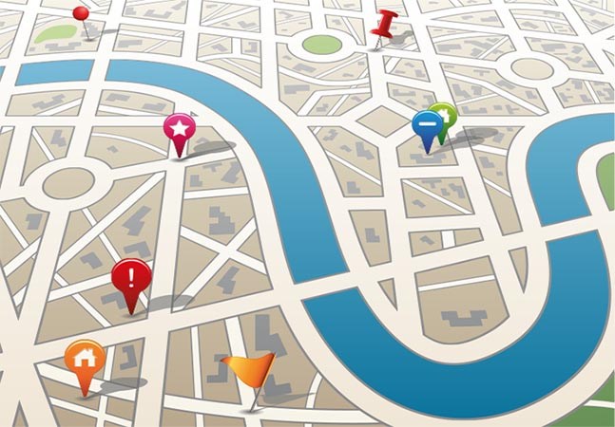
Unit 1: roadmap
1.1 What is a system of systems?
1.2 SoS challenging problems?
theoretical problems
implementation problems
1.3 Conclusions

Slide 5

What is a system of systems (SoS)
A class of complex systems whose constituents are themselves complex
Performance optimization, robustness, and reliability among an emerging group of heterogeneous systems
Goal: realize a common goal
achieving synergy between independent systems to achieve the desired overall system performance

Slide 6
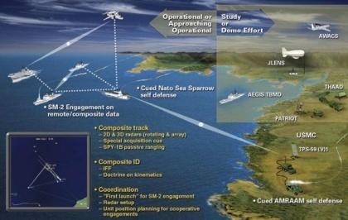
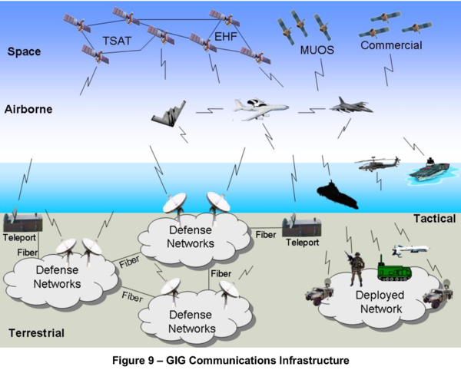

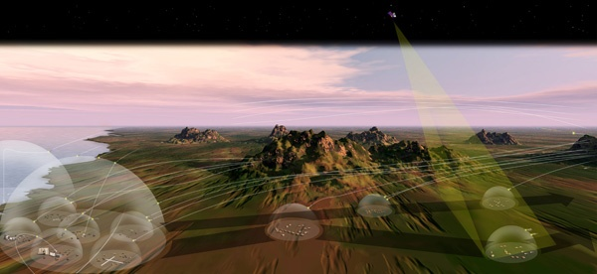
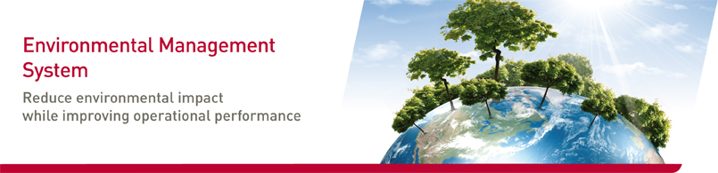
SoS applications
Military, security, aerospace, space, manufacturing, service industry, environmental systems, and disaster management, …
Notes:
Defense and commercial sectors

Slide 7
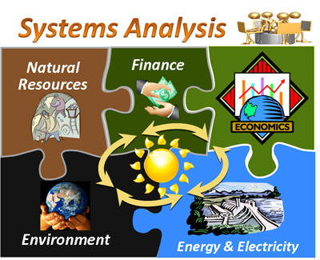


Why using SoS concepts?
The main thrust behind the desire to view the systems as an SoS is
to obtain higher capabilities and performance than would be possible with a traditional system view.
The SoS concept presents a high-level viewpoint and explains the interactions between each of the independent systems.
Still at its developing stages

Slide 8
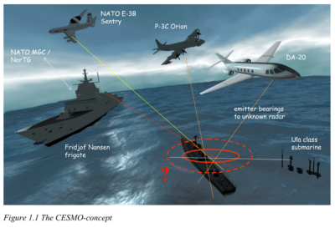
SoS – a practical definition
A system of systems (SoS) is a “supersystem” comprised of other heterogeneous elements that themselves are independent complex operational systems and interact among themselves to achieve a common goal.
The goal may be cost,
performance, robustness…
Notes:
substantiate
英 [səbˈstænʃieɪt] 美 [səbˈstænʃiˌeɪt]
vt. 用事实支持（某主张、说法等），证实；使具体（实体）化
网 络 使实体化；
确证；
使实体化 证实；
使具体化 证实

Slide 9
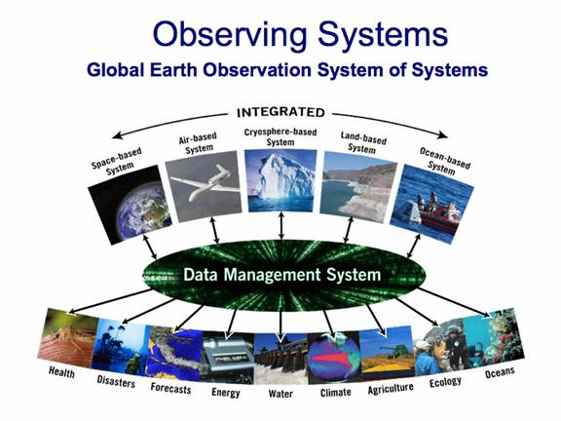
SoS – other relevant definition
Systems-of-Systems (SoS) describe the large scale integration of many independent self-contained IT systems to satisfy global needs from citizens, taking into account multi-system requests.
Notes:
self-contained 自给的，独立的; 设备齐全的; 自给自足的; 沉默寡言的

Slide 10

SoS – More definitions
SoS exist when there is a presence of a majority of the following five characteristics: ①operational and ②managerial independence, ③geographic distribution, ④emergent behavior, and ⑤evolutionary development (Jamshidi, 2005).
SoS integration is a method to pursue development, integration, interoperability, and optimization of systems to enhance performance in future battlefield scenarios (Pei, 2000).
SoSE involves the integration of systems into systems of systems that ultimately contribute to evolution of the social infrastructure (Luskasik, 1998).
In relation to joint warfighting, system of systems is concerned with interoperability and synergism of command, control, computers, communications, and information (C4I) and intelligence, surveillance, and reconnaissance (ISR) systems (Manthorpe, 1996).
…
Notes:
synergism
生词本
英 ['sɪnədʒɪzəm] 美 ['sɪnədʒɪzm]
n. 神人协力合作说，合作；增效；增剂作用；协同
网 络 协同作用；
协同酌；
增效作用；
协合作用

Slide 11





More SoS definitions
SoS integration:
A method to pursue development,
integration,
interoperability, and optimization
of systems to enhance performance in future battlefield scenarios
SoS five characteristics:
①operational independence
②managerial independence ③geographic distribution ④emergent behavior ⑤evolutionary development
SoSE
involves the
integration of systems into SoS that
ultimately contribute
to evolution of the social infrastructure
In relation to joint war-fighting,
SoS is concerned with interoperability and synergism of command, control, computers, communications, and information (C4I) and intelligence, surveillance, and reconnaissance (ISR) systems.

Slide 12
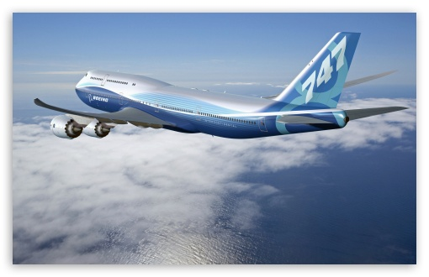
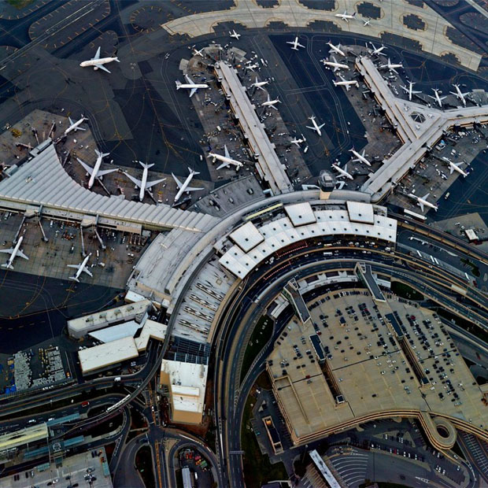
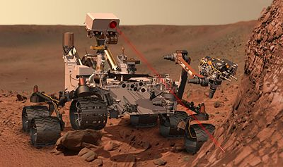
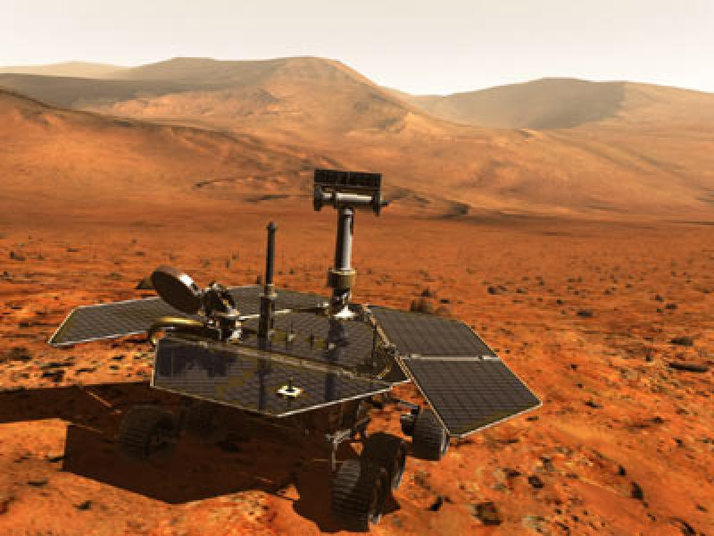
SoS examples
An airport is an SoS
a Boeing 747 airplane, as an element
of an SoS, is not SoS
A robotic colony (or a robotic swarm) exploring the red planet, or any other place, is an SoS.
a rover on Mars is not an SoS
Notes:
rover
生词本
英 [ˈrəʊvə(r)] 美 [ˈroʊvə(r)]
n. 流浪者，漫游者
网 络 罗孚；
路华；
英国罗孚；
漂泊者

Slide 13
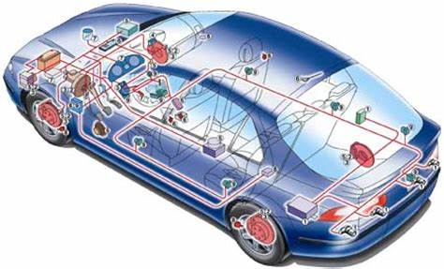
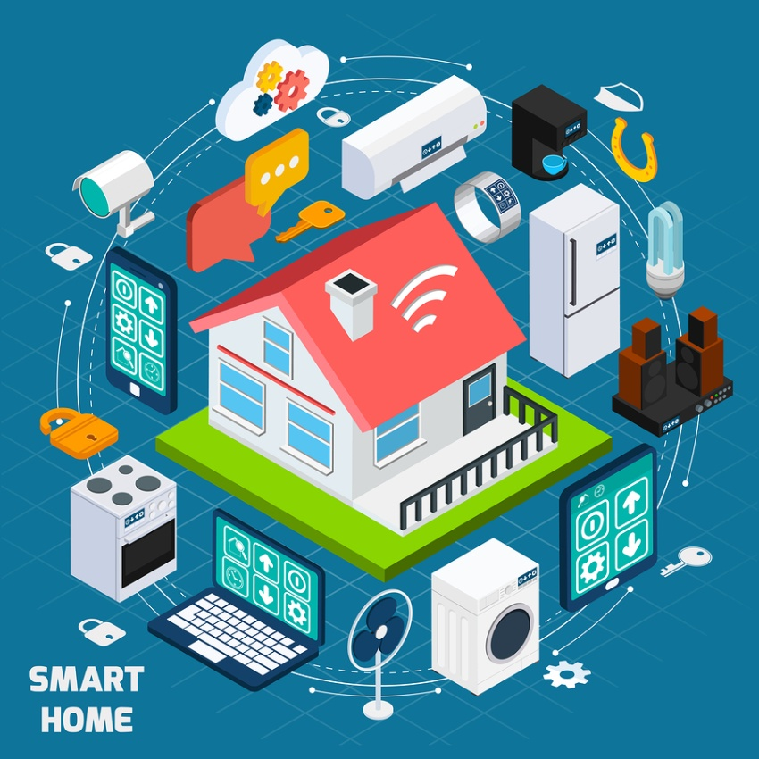



SoS are everywhere
Today software-intensive systems are ubiquitous.
We have software embedded in our automobiles, household appliances, and even computers and sensors on our bicycles to tell us how far we have gone and our average speed.

Slide 14
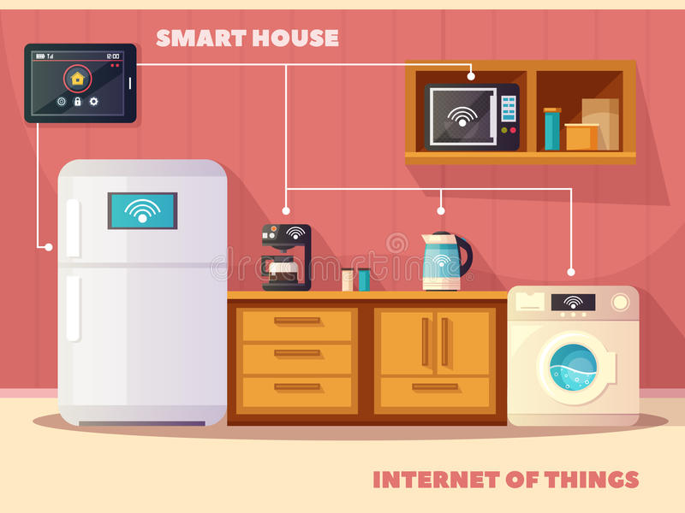

Slide 15
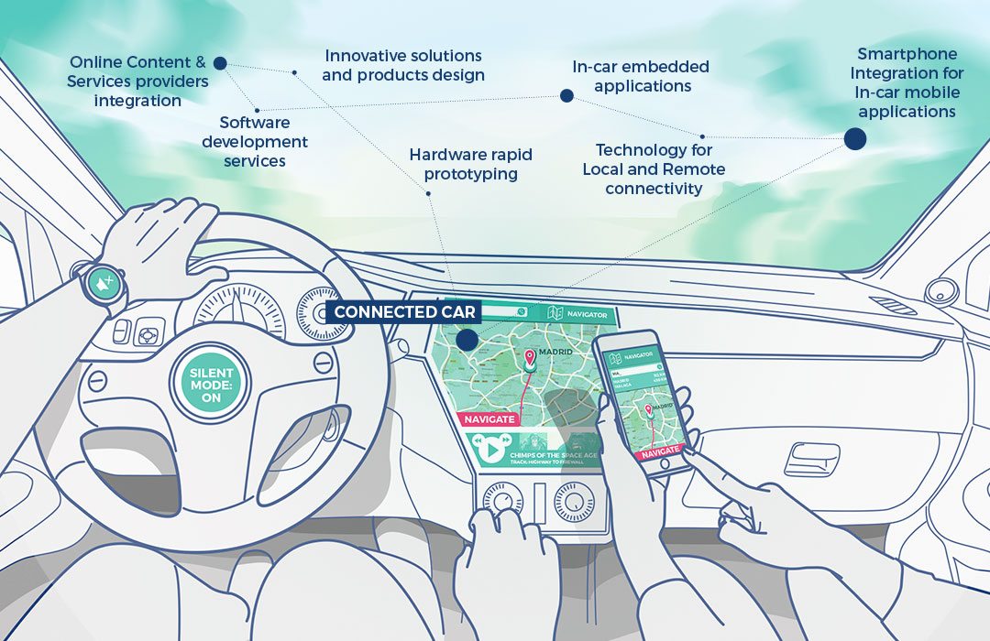

Slide 16



The undergoing example in 2020
Bill Gates TED speech (Apr. 2015)
On The next outbreak? We‘re not ready
在《传染病》这部影片中，我们不仅能看到人类制造的工业文明，对自然界的破坏和杀戮，也能看到在互联网时代，有人为了谋取利益，而借助舆论制造出的弥天大谎。
还能看到，灾难降临之时，有人为了基本的生存，而进行的殴打和哄抢，甚至是秩序的失控，以及引领者威信力和话语权的丧失。
人类花费了几千年所创造的文明，在自然的反击之下，可以轻而易举地被击垮。

Slide 17
Unit 1: roadmap
1.1 What is a system of systems?
1.2 SoS challenging problems?
theoretical problems
implementation problems
1.3 Conclusions

Slide 18


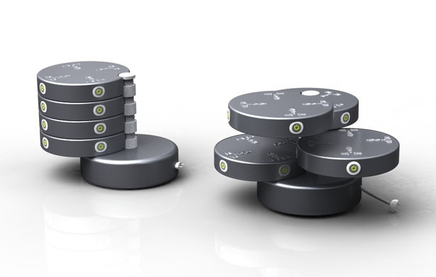
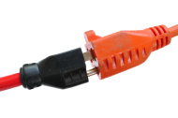
Challenging problems in SoS
No engineering field is more urgently needed in tackling SoS problems than system engineering (SE) → SoSE
How to extend SE concepts such as analysis, control, estimation, design, modeling, controllability, observability, stability, filtering, simulation, and so on that can be applied to SoS?
How can one model and simulate SoS?

Slide 19
Unit 1: roadmap
1.1 What is a system of systems?
1.2 SoS challenging problems?
theoretical problems
implementation problems
1.3 Conclusions

Slide 20

Theoretical problems
SoS continuum
Open systems approach to system of systems engineering (SoSE)
Engineering of SoS
Standards of SoS
SoS architectures
SoS simulation
SoS integration
Emergence in SoS
SoS management

Slide 21

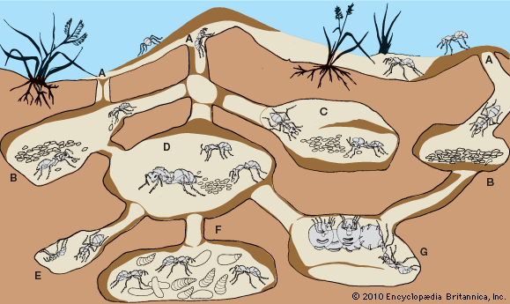

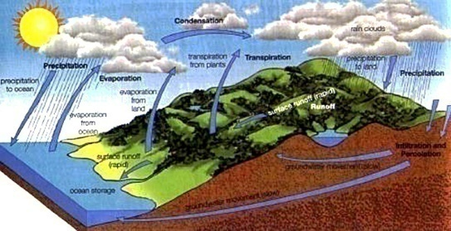
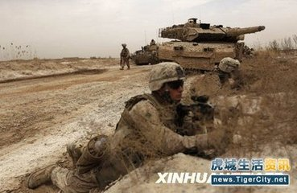

SoS continuum
ad-hoc
short-lived
simple SoS
e.g., military operations and less sophisticated biotic systems
evolving
long-lasting
complex SoS
e.g., galactic and
more sophisticated biotic systems
bacteria
galaxy
ant colonies
ecosystem
Human colony
Notes:
human colony 人类群体
Ad-hoc 点对点， 特别的

Slide 22
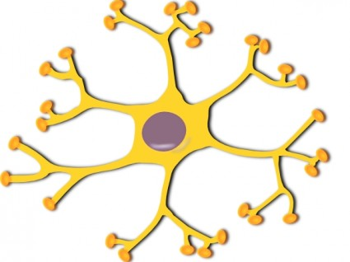
Open systems approach to SoSE
The engineering approaches utilized by galactic SoS are at best unknown and perhaps forever inconceivable.
Biotic SoS seem to follow less complicated engineering and development strategies (open system strategies)
Open systems development principles and strategies
e.g., modular design, standardized interfaces, emergence, natural selection, conservation, synergism, symbiosis, homeostasis, and self-organization
their implications for engineering of man-made SoS
Notes:
At best 至多， 充其量; 顶多
Symbiosis （通常互利的）共生（现象）; （人与人之间的）互利关系
synergism 神人协力合作说，合作; 增效; 增剂作用; 协同
Homeostasis n.动态静止; 动态平衡; （社会群体的）自我平衡; 原状稳定
英 [ˌhəʊmiəˈsteɪsɪs]
inconceivable 搜索网络
英 [ˌɪnkənˈsi:vəbl] 美 [ˌɪnkənˈsivəbəl]
adj. 不能想像的，不可思议的，难以置信的; 〈口〉难于相信的，惊人的;
galactic
英 [gəˈlæktɪk] 美 [ɡəˈlæktɪk]
adj. 银河的;

Slide 23

SoS several principal characteristics
Operational independence of the individual systems
Managerial independence of the individual systems
Often large geographic and temporal distribution of the individual systems
Emergent behavior
these behaviors arise as a consequence of the formation of the entire system family and are not the behavior of any constituent system
Notes:
时间的;时间方面的 Temporal means relating to time
managerial 搜索网络
英 [ˌmænəˈdʒɪəriəl] 美 [ˌmænəˈdʒɪriəl]
IELTS
adj. 经理的; 管理上的;
swarm behavior 群行为
Birds flocking is an example of emergent behaviour from simple rules.
Swarm intelligence 群智能
“emergent behaviors”: where an SoS can perform functions that cannot be provided by any of the constituent-systems
“emergent behavior” does not appear to be a system characteristic unique to SoSs.
What is controversial in the SoS arena is whether emergent behaviors should be planned and managed.
There are others that are concerned that if one is not careful, there may be undesirable emergent behaviors (e.g., safety or security problems), and to avoid these problems, emergent behaviors must be carefully planned, tested, and managed

Slide 24

Engineering of SoS
Much interest in the engineering of SoS
A system of systems is never fully formed or complete
SoS development is evolutionary and adaptive over time
Structures, functions, and purposes are added, removed, and modified as experience of the community with the individual systems and the composite system grows and evolves.
The SoS engineering and management pose special challenges.
Especially related to multiple contractors and interests

Slide 25
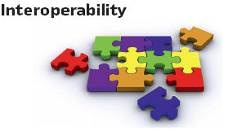




Standards of SoS
Standards can facilitate a common understanding and approach
help unify and advance the discipline for engineering, healthcare, banking, space exploration
help all other disciplines that require interoperability among disparate systems.
Notes:
什么是Interoperability
Interoperability其实并不是一个单纯的互联网医疗领域的概念，大多数时候Interoperability被翻译为互操作性，或者协同工作能力等。
在一般意义上，指的是不同的设备、信息系统以及组织机构之间共享信息、相互合作、协同工作的能力。
discipline
英 [ˈdɪsəplɪn] 美 [ˈdɪsəplɪn]
vt.训练； 使有纪律； 处罚； 使有条理
disparate 搜索网络
英 [ˈdɪspərət] 美 ['dɪspərət]
GRE
adj. 完全不同的; 从根本上种类有区分或不同的;
n.训练； 纪律； 学科； 符合行为准则的行为（或举止）
Disparate adj.完全不同的; 从根本上种类有区分或不同的

Slide 26

SoS architecting
Business and government applications require integrated systems that exhibit intelligent behavior
Instead of designing or subcontracting systems from scratch, business or government gets the best systems
the industry develops and focuses on becoming the lead system integrator to provide SoS.
Artificial life tools for the design and architecting of SoS
swarm intelligence, evolutionary computation, and multi-agent systems
Notes:
Swarm intelligence 群智能
Evolutionary adj.进化的
subcontract
英 [ˌsʌbkənˈtrækt] 美 [ˌsʌbˈkɑntrækt]
vt.（将大工程）转包，分包； 制定[履行]转包；
n.转包契约；

Slide 27
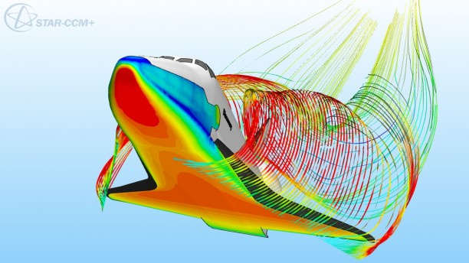
SoS simulation
An SoS architecture based on Extensible Markup Language (XML)
in order to wrap data coming from different systems in a common way
the XML can be used to describe each component of the SoS and their data in a unifying way
the only requirement for the SoS components is to understand/parse XML file
XML does not only represent data but also gives useful information
that can be used in the SoS to take better actions and to understand the situation better

Slide 28

SoS integration
Integration is probably the key viability of any SoS
Integration of SoS implies that each system can communicate and interact (control)
They need to have the ability to communicate with each other
A common language is needed
Notes:
Viability n.生存能力，发育能力; 生活力
Viable adj. 切实可行的; 能养活的; 能自行生产发育的; 有望实现的

Slide 29
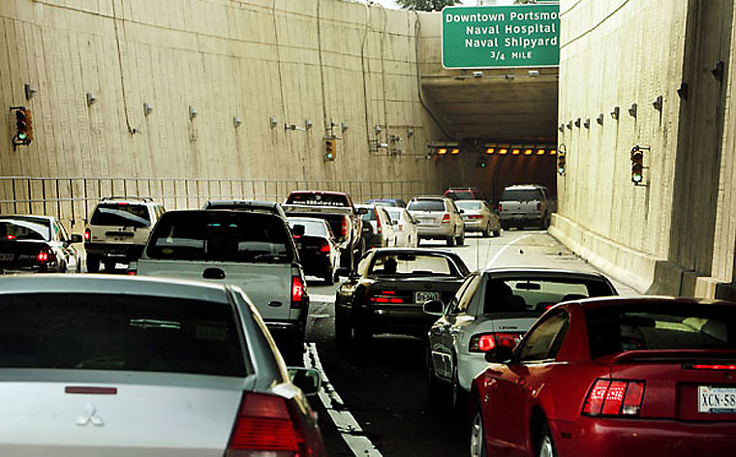
Emergence in SoS (1)
Emergent behavior of an SoS resembles the slowdown of the traffic going through a tunnel, even in the absence of any lights, obstacles, or accident.
Notes:
Resemble vt.与…相像，类似于

Slide 30

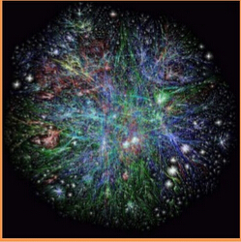

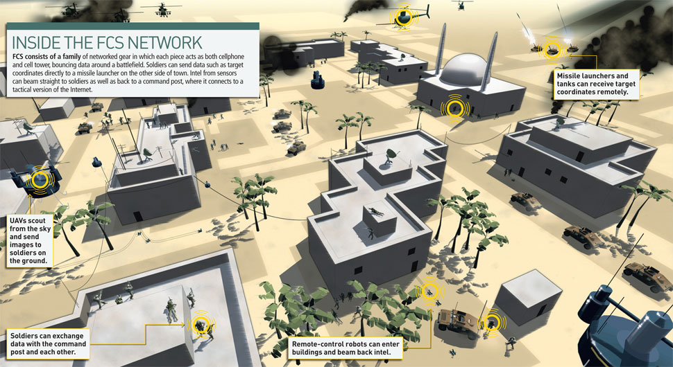
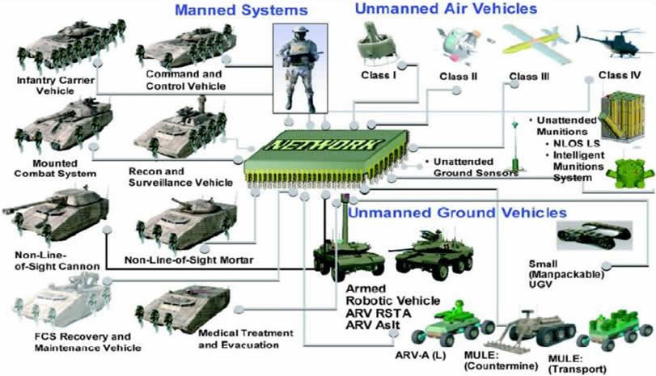
Emergent behaviors
synchronized flashing
of fireflies
http://www.reach-unlimited.com/p/645398991/when-fireflies-thrive
http://www.creationmoments.com/radio/transcripts/synchronized-fireflies
http://blog.whiteoaklodgeandresort.com/2015/06/10/synchronous-fireflies-put-on-a-pretty-show/
The Internet leads to emergent behaviors
a future combat system
the flocking of birds
Notes:
Combat system 作战系统
Components are instead connected into larger networked systems that can exhibit collective, group behaviors that are not apparent from analysis of the individual parts.
These emergent behaviors can either improve the system's function or can create instabilities.
Light pollution might be interfering with fireflies mating. Both male and female fireflies use their flashing lights to communicate. Some species synchronize their flashes, sometimes across large groups of thousands of insects. All species communicate with each other at night with their blinking lights: from wooing females, defending their territory, and warning about nearby predators.

Slide 31

Emergence in SoS (2)
An SoS cannot achieve its goals depends on its emergent behaviors
After exploring “interdependencies among systems, emergence, and interoperation”, maxim-like findings are developed:
Because they cannot control one another, autonomous entities can increase their influence through cooperative interactions with others
Emergent composition is often poorly understood and sometimes misunderstood because it has few analogies in traditional systems engineering
Delay is a critical aspect of systems of systems
…
Notes:
Maxim n.格言，座右铭; 准则
Autonomous entity 自治实体
Composition n.作文，作曲; 创作; 构图，布置; 妥协，和解

Slide 32

SoS management: the governance of paradox
For various SoS, the same emergent principles apply:
large is really small, weak is really strong, significance is really obscure, little means a lot, simple is really complex, and complexity hides simplicity.
The conceptual foundation of complexity is paradox
It is our ability to govern, not control, these paradoxes that will bring new knowledge to our understanding on how to manage the emerging complex systems called system of systems.
Notes:
paradox
反论，悖论；似非而是的论点；自相矛盾的人或事；[物]佯谬
网 络 悖论；
矛盾；
吊诡；
自相矛盾
The existence of paradox is always the inspirational source for seeking new wisdom, attempting new thought patterns, and
ultimately building systems for the “flat world.”

Slide 33
Unit 1: roadmap
1.1 What is a system of systems?
1.2 SoS challenging problems?
theoretical problems
implementation problems
1.3 Conclusions

Slide 34

Implementation problems
SE for Dept. Defense System of Systems
e-Enabling and SoS aircraft design via SoSE
A SoS perspective on infrastructures
Sensor networks
A SoS View of Services
SoSE in space exploration
Communication and Navigation in Space SoS
Electric Power Systems Grids as SoS
Transportation Systems
Healthcare Systems
…

Slide 35

SE for Dept. Defense SoS
Military operations are the synchronized efforts of people and systems toward a common objective.
from an operational perspective, defense is essentially a “system of systems” enterprise
Most of these military systems, operated as part of a SoS,
were designed and developed without the benefit of SE at the SoS level .
Notes:
Systems Engineering for the Department of Defense System of Systems
Government defense organizations are sometimes required to work together to perform some of their missions. These joint missions may call upon army, navy, marine corps, and air force systems to interoperate with each other. Examples of types of systems that must interoperate in this environment include command and control, communications, and medical care systems.

Slide 36
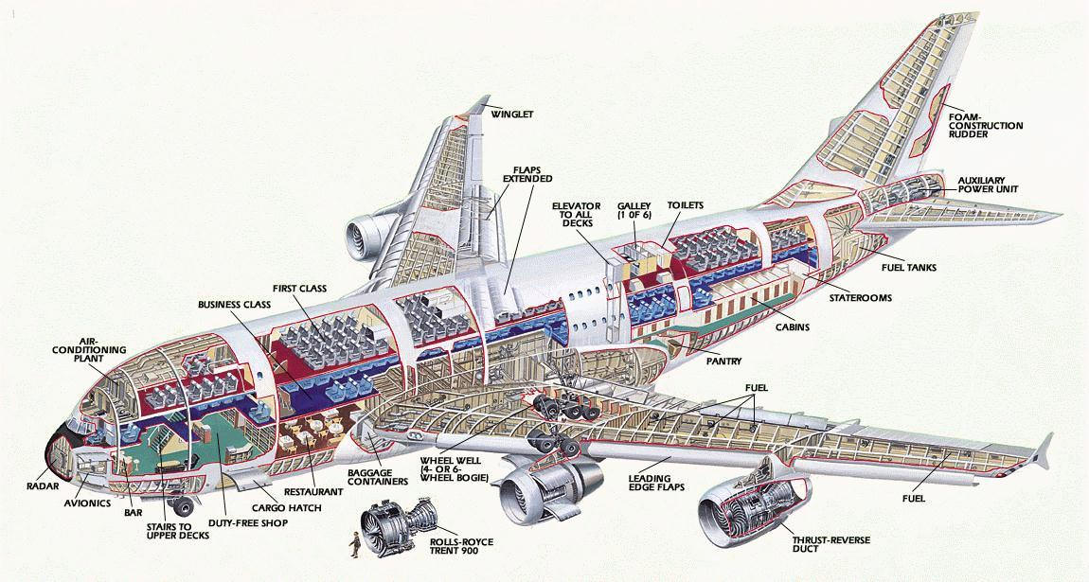
e-Enabling and SoS aircraft design via SoSE
Boeing Commercial Aircraft Division
Developing a strategy and technical architecture to facilitate making the airplane network-aware and capable of leveraging computing and network advances in industry
include many ground-based architectural components at the airlines and at the Boeing factory, as well as other key locations such as the airports, suppliers, and terrestrial (ISPs).
Defining a SoSE solution to problem of interoperation and communication
Notes:
波音商用飞机部
defining a system of systems engineering solution to problem of interoperation and communication
The objective has
been to find ways of leveraging network-centric operations, to reduce production,
operations and maintenance costs for both Boeing and the airline customers.

Slide 37
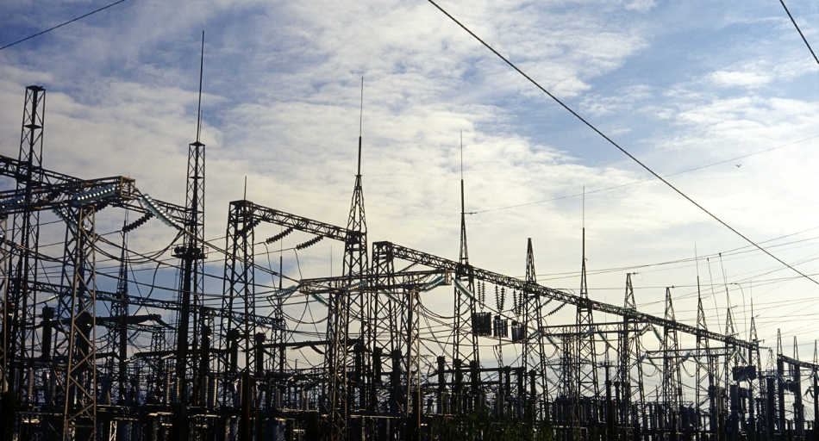
A SoS perspective on infrastructures
Infrastructure systems (or infrasystems) providing services which are vital to the functioning of modern society.
such as energy, transport, communications, and clean and safe water
While each of the infrasystems can be seen as a complex SoS in itself, increasing interdependency among these systems (both technologically and institutionally) adds a layer of complexity.
One approach to increased understanding of complex infrasystems is to focus on the commonalities of the different sectors and to develop generic theories and approaches
such that lessons from one sector could easily be applied to other sectors

Slide 38
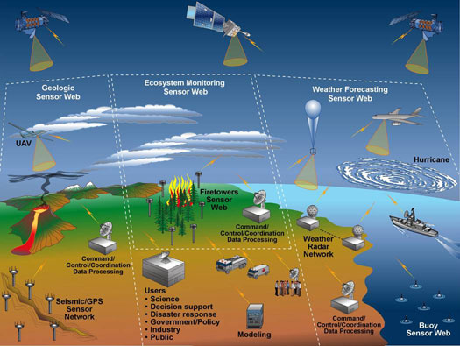
Sensor networks
The main purpose of sensor networks is to utilize the distributed sensing capability to capture events or monitor space more effectively
The realm of applications for sensor networks is quite diverse
include military, aerospace, industrial, commercial, environmental, and health monitoring
Communication capability of these small devices and often with heterogeneous attributes makes them good candidates for SoS.
Notes:
Applications include traffic monitoring of vehicles, cross-border infiltration
detection and assessment, military reconnaissance and surveillance, target
tracking, habitat monitoring and structure monitoring, and so on.

Slide 39

A SoS View of Services
Service industry – the services sector employs a large and growing proportion of workers in the industrialized nations
it is increasingly dependent on information technology (IT).
Considerable differences between goods and services, including the shift in focus from mass production to mass customization
In general, a service system can be considered to be a combination or recombination of three essential components—people, processes, and products
Notes:
mass customization (whereby a service is produced and delivered in response to a customer’s stated or imputed needs
In general, a service system can be considered to be a combination or recombination of three essential components—people (characterized by behaviors, attitudes, values, etc.), processes (characterized by collaboration, customization, etc.), and products (characterized by software, hardware, infrastructures, etc.).
Customization n.用户化，专用化，定制

Slide 40

SoSE in space exploration
Specific emphasis: how software and electronics are revolutionizing the way space missions are being designed
including both the capabilities and vulnerabilities introduced.
SoSE space missions will have extremely large, complex, and intertwined command and control and data distribution ground networks
involve extensive parallel processing to produce tera-to-petabytes of products per day and distribute them worldwide.
Notes:
intertwine
英 [ ˌɪntəˈtwaɪn ] 美 [ ˌɪntərˈtwaɪn ]
GRE /
vt.缠结在一起; 使缠结
vi.纠缠; 编结
Space Exploration SoS: Systems such as the Mars Science Laboratory (MSL) (http://mars.jpl.nasa.gov/msl/mission/rover/) can also be viewed as an SoS given the variety of research systems placed upon the exploration rover platform that must interoperate with each other. MSL science instruments are developed and maintained by various organizations, yet designed to interoperate with each other to support the MSL missions. For example, the rover Mastcam camera must interoperate with other science instruments to record conditions under which various Mars samples are collected.

Slide 41
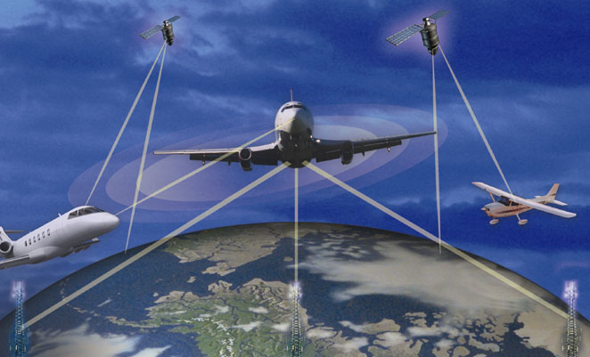
Communication and Navigation in Space SoS
Communication and navigation networks provide critical services
in the operation, system management, information transfer, and situation awareness to the space SoS
In addition, space SoS are requiring system interoperability, enhanced reliability, common interfaces, dynamic operations, and autonomy in system management.
new approaches to communications and navigation networks are required
many SoS may include communication networks that are also SoS.
Notes:
Navigation n.航行（学）; 航海（术）; 海上交通

Slide 42

Electric Power Systems (EPS) Grids as SoS
An overview of the SoS that are fundamental to the operation and control of EPS are provided.
Power systems cover extensive geographical regions and are composed of many diverse components.
Stable operation is achieved through extensive monitoring systems and a hierarchy of controls.
Safety margins play an important role in ensuring reliability, but tend to incur economic penalties.
reduction of these safety margins

Slide 43

Transportation Systems
Intelligent Transportation System (ITS) can be viewed as a collection of layered networks composed by heterogeneous systems.
At present, research on each sector of the ITS is generally conducted independently
with infrequent and/or incomplete consideration of scope dimensions and network interactions
This isolated treatment does not capture the higher level interactions
Systematic method for modeling these interactions with a SoS approach is essential
especially vital as decision makers in both the public and the private sector,

Slide 44
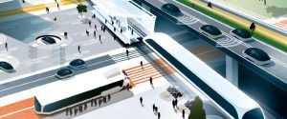
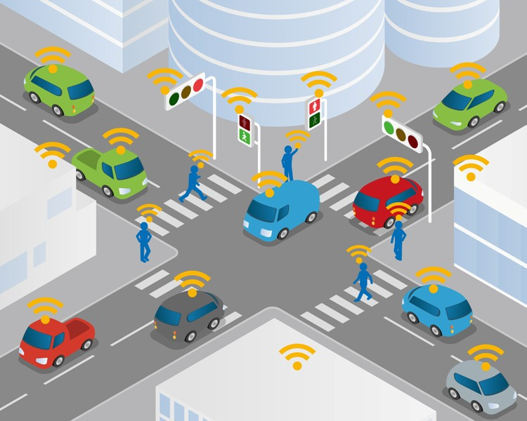
Intelligent Transport System (ITS)
aims to achieve traffic efficiency by minimizing traffic problems.
aims to reduce time of commuters as well as enhances their safety and comfort.

Slide 45


Healthcare Systems
National Healthcare Information Network (NHIN), with the goal of creating a nationwide information system that can build and maintain Electronic Health Records (EHRs) for all citizens
The NHIN will rely on a network of independent Regional Healthcare Information Organizations (RHIOs)
a very complex SoS
Simulation, modeling, and other appropriate SoSE tools are under development.
Notes:
Efficacy n.功效; 效力; 效验; 生产率
Amazon Echo and Google Home
The dream of a smart home that's automated and helps you with tasks throughout the day is one of Silicon Valley's current obsessions. Amazon and Google have begun peddling the vision to consumers with the Amazon Echo and Google Home. Tech giants have also made broader bets in AI: Facebook has tech that tries to push the boundaries of facial recognition, and Google has software that can beat humans in a game of Go.
What if all the devices in your life could connect to the Internet? Not just computers and smartphones, but everything: it's the Internet of Things (IoT), and it's a key component of home automation and smart homes.

Slide 46
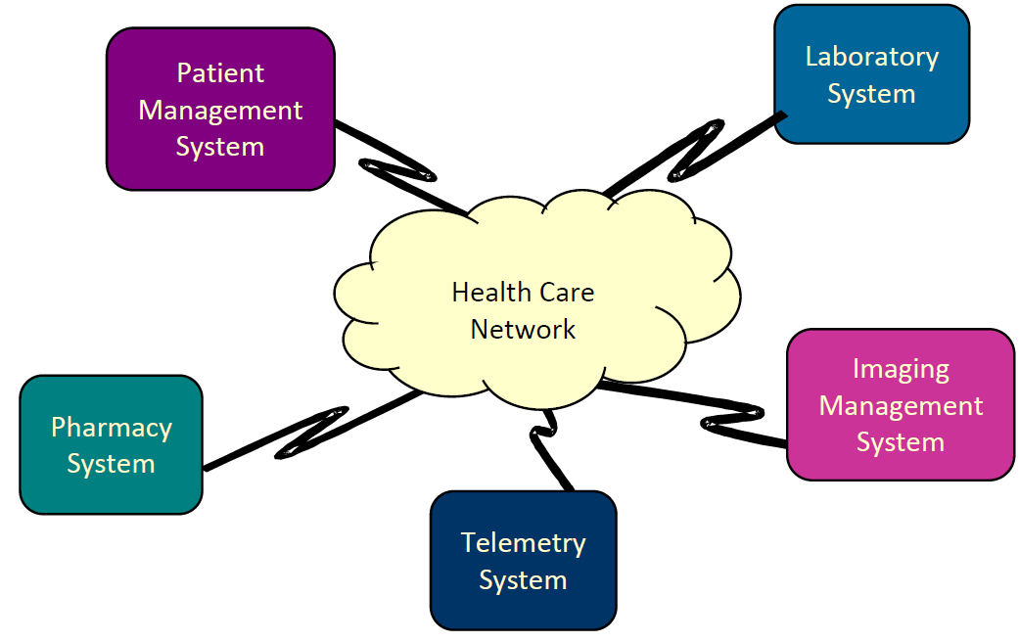
Healthcare SoS

Slide 47
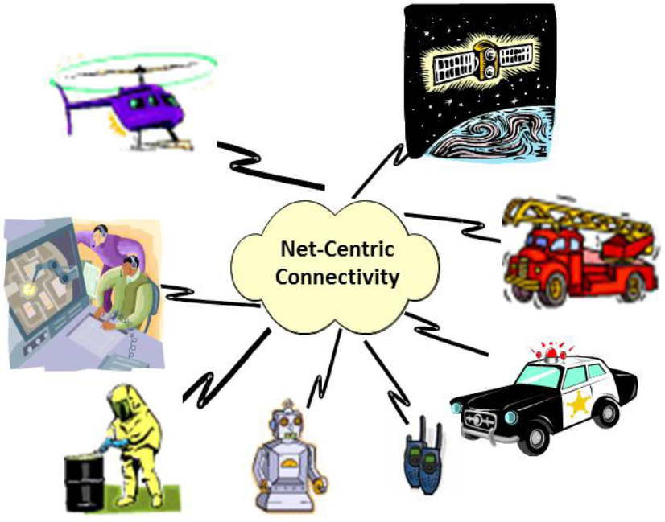
Dynamic Crisis Response SoS
Notes:
If the crisis is a hazardous material spill on a busy freeway, the first responders may again be a fire department (since they are most easily deployed). But this time, they are supported by hazardous materials specialists to help determine the type of material spilled and the appropriate methods for removing the materials and decontaminating the area. In some cases, robots may be used to collect spill samples and/or decontaminate the area. Also, it may also be necessary to evacuate people in the area. So, again, the police, aerial vehicles, and other systems may be used to help with this activity.
Figure 2 illustrates some of the systems that may be called upon to respond to various crises as well as a command center that is used to help coordinate the activities of these systems.
Global Positioning System (GPS) [NAVSTAR, 2006] that is today considered both as a SoS and a constituent-system for other SoSs

Slide 48
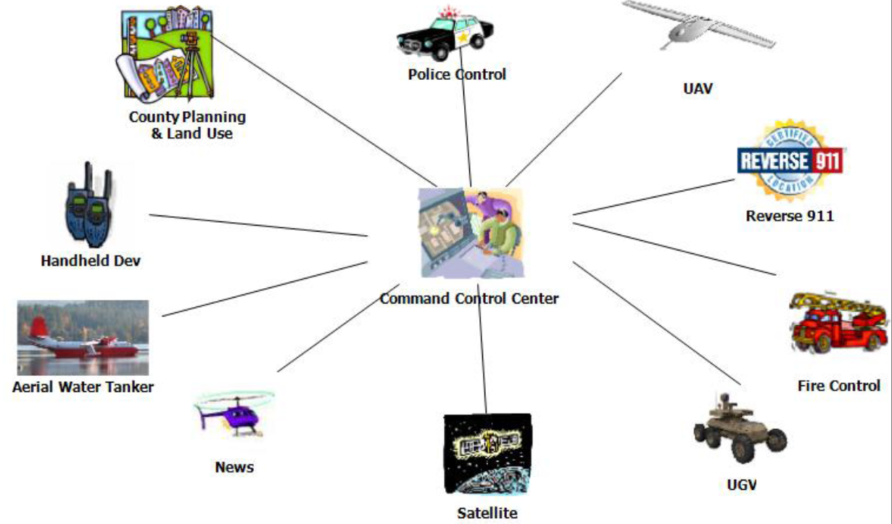
Regional Area Crisis Management SoS

Slide 49






More topics
Global Earth Observation SoS
Deepwater Coastguard Program
Future Combat Missions
National Security
Critical Infrastructure and Air Transportation Security
Notes:
Coastguard n.海岸警卫队; 海岸警卫队队员

Slide 50
Unit 1: roadmap
1.1 What is a system of systems?
1.2 SoS challenging problems?
theoretical problems
implementation problems
1.3 Conclusions

Slide 51

Conclusions
The subject matter is an unsettled topic in engineering in general and in systems engineering in particular.
Attempt has been made to cover as many open questions in both theory and applications of SoS and SoSE.

Slide 52
Main differences between SOSE and SE
Scope | SE | SOSE
Research focus | Single complex system | Integration of multiple complex systems
Target | Optimization | Satisfaction
Method | Procedure | Methodology
Expected results | Solution | Initial response
Problem | Definable | Emergence
Analysis | Technology oriented | environmental impact oriented
Results | Single | Multiple
Boundary | Fixed | unfixed
Notes:
SE重点研究单复杂系统，SOSE重点研究多复杂系统。
SE的目标是系统性能指标最优化，而SOSE的目标是实现“满意的”性能指标。受限于SoS环境的不确定性和复杂性。SoS通常无法实现“最优化”性能指标。
SE强调简化约束条件，聚焦于技术领域；而SOSE必须综合考察技术、人员、政策，以及环境等多种因素。
SE要求目标系统慢煮，可定义、固定的、单一的；而SoSE目标系统无法准确定义，并且多目标并存。
SE确定在技术领域，而SOSE边界不固定，甚至不断变化，主要由于不断出现新技术，新条件和新需求。

Slide 53
 | 人工系统（一般系统） | 复杂系统 | 体系
组成 | 元素及其关联 | 元素、系统和交互 | 系统与交互
元素关系 | 相互依赖 | 相互依赖或涵盖 | 相互交互与独立
基础结构 | 简单、有序、稳定 | 复杂、动态 | 网络环境中动态演化
组成单元的独立性 | 不具备独立性 | 在同一环境中，局部或部分组成元素具备独立性 | 在同一环境中，组成元素独立运作。
组成单元的耦合性 | 紧耦合 | 相互依赖、重叠 | 松耦合、非重叠
边界与环境 | 确定的边界和同外部环境的交互 | 确定边界与复杂的交互 | 模糊的或者不断变化的边界，不确定的交互
生命周期 | 有具体的设计生命周期（可被延长） | 没有定义或者无时限 | 没有定义或者无时限
复杂性 | 能够实现解决问题的最优化 | 复杂，通过建模与仿真手段解决问题 | 高度复杂，几乎没有最优化解决途径
自主性 | 保障了系统的自主性而放弃组成单元的自主性 | 组成单元的自主或半自主行为 | 组成单元的自主性行为成就体系的整体目标的完成
连通性 | 通过预先的设计，使得在组成单元间具备良好的连通性（人工系统） | 存在复杂的交互，但在子系统间不具备连通的基础结构 | 通过网络中心的体系结构在组成单元间动态建立单元间的连接
功能与能力的多样性 | 相对稳定的功能模式，不具备多样性 | 具备多样性，多样性源于不可控的复杂交互 | 具备较强的多样性，源于组成单元的自主性和连接的开放性
涌现行为 | 涌现行为无论好与坏都是可以预见的 | 组成个体的层次与交互导致不可预见的涌现行为 | 个体行为的积累与个体间的交互导致不可预见的涌现行为
工程行为 | 通过系统工程精心设计与控制，规范其行为 | 只能干涉，而不能规范其行为与发展 | 通过体系统工程指导其行为、牵引其发展
实例 | 机车动力系统、单一指控系统、雷达探测系统等 | GIG、Internet、社会组织、生态系统 | 防空体系、导弹防御体系

Slide 54


Why do we need to learn SoS?
Research in SoS should lead PROMPTLY AND DIRECTLY into education.
There will be high demand for students who have even primitive knowledge in this emerging area.

Slide 55

Study an engineered SoS that you are interested in.
Describe it with pictures and texts.
Present it with PPTs in 20 mins (i.e., approximately in 20 slides ).

